Slide 1
ОСОБЕННОСТИ ПРОФЕССИОНАЛЬНО ОРИЕНТИРОВАННОГО ДИСКУРСА: ЛИНГВОДИДАКТИЧЕСКИЙ ПОТЕНЦИАЛ
С.Л. Климинская,
канд. филол. н., доцент Департаментa английского языка и профессиональной коммуникации Финансового университета при правительстве РФ

Slide 2
ПРОФЕССИОНАЛЬНОЙ ДИСКУРС
институциональность
интенциональность
шаблонность речевого поведения
клишированность речевого поведения
тематическая очерченность
вариативность форм
структурность дискурса
когнитивные особенности
эмотивно-аксиологические особенности

Slide 3
Обучение профессиональному дискурсу

Slide 4
Обучение профессиональному дискурсу
LEAD-IN
1. Before you read the text, say what you know about IT risks and their nature? Do you have any ideas how to treat risks and reduce them?
2. Explain what the following terms and topic-related words mean: risk, risk management, information security risk management culture
Make sure you know how to pronounce the following words:
risk averse; circumstance; private use; variety of risks; environment; specific categories; varying level; senior management; finance; identify; holistic picture; legal and regulatory environment; undesirable consequences; exposure; effect; to subject / a subject; uncertainty; impact; parameter; exploit; governance; essential component; due diligence; affect; confidentiality; availability; internal control system; risk management process; human resources; issue; appetite; maintenance; committee; to report / a report;

Slide 5
Обучение профессиональному дискурсу
BASIC VOCABULARY
1) Give Russian equivalents for the following English words all found in the text above.
risk management ; risk; information security risk; personal data; security controls; personal data ; risk taker; risk averse; the risk of exposure; due diligence; variety of risks; regulatory environment; corporate governance; uncertainty ; likelihood; the board of directors;
Complete the collocations from the text, reproduce the context they are used in.
to exclude groups from the situation
To depend on the particular circumstances
To protect information from risks
Form partnerships as they occur in the text , use these expressions in sentences of your own.
4) From the box below choose words and word combinations to speak about:
• How to protect an organization's critical information and assets by ethically integrating cybersecurity
to handle information | risks
to take | outcomes
to experience | the risk
to counter the effects | of a threat
to predict unknown | assets
boundaries for security management; elements of guidance; security breach; governance principles; unconventional attacks; systemic security life cycle; business continuity; governance provisions; a “zero tolerance” approach; …

Slide 6
Концептологический подход
узнаваемые концепты, имеющие отношение к той или иной культуре (primary election; a whip; Member of Parliament; suffrage; franchise)
2) концепты, референтами которых являются национально-специфические явления (life-time employment; promotion by seniority)
3) концепты, требующие при работе с текстом определенной обработки представленной в них информации (the Japanese business system; Japanese competition, doing business in the Middle East)

Slide 7
 | renewable |  | renewable energy
 | carbon | carbon emission | green carbon |  | business
 | ecological |  | green business
 | green | greenness | green audit |  | labelling
Ecology |  | greenhouse gas | green certification | certification |  | Economy
 | climate change | climate breakdown | slow city |  | production
 |  | anti-consumerism | green consumer
 | eco-friendly |  | eco-footprint
 |  |  | eco-labelling

Slide 8
Концепт | Составляющие элементы | Значение | Субдискурс | Лексикографичес-кая фиксация
ecotage | ecology + sabotage | саботаж по экологическим мотивам, как правило, направленный против крупных загрязнителей окружающей среды | Экологический, Социальный | Collins dictionary
vertical (skyscraper) farming | вертикальное фермерство | технология ведения сельского хозяйства высокоурожайность эффективность экономия ресурсов отсутствие влияния на окружающую среду | Экономический / экологический | Cambridge dictionary
Carrotmobbing | акция по поддержке торговой организации, реализующей экологически чистые продукты | поддержка торговое предприятие массовое приобретении товаров экологически чистая продукция лояльность | экономический субдискурс | Macmillan dictionary
climate canary | вызванное изменением климата непредвиденное событие/явление, которое является предвестником возможной кактастрофы | природное явление изменение климата климатическая / экологическая катастрофа | экономический субдискурс | Macmillan dictionary

Slide 9
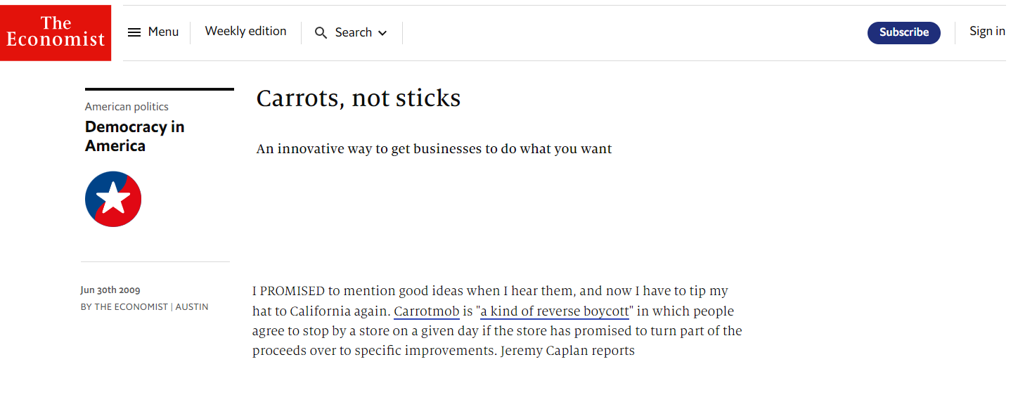
CARROTS, NOT STICKS
An innovative way to get businesses to do what you want
I PROMISED to mention good ideas when I hear them, and now I have to tip my hat to California again. Carrotmob is "a kind of reverse boycott" in which people agree to stop by a store on a given day if the store has promised to turn part of the proceeds over to specific improvements. Jeremy Caplan reports
Jun 30th 2009
BY THE ECONOMIST | AUSTIN
https://www.economist.com/democracy-in-america/2009/06/30/carrots-not-sticks

Slide 10
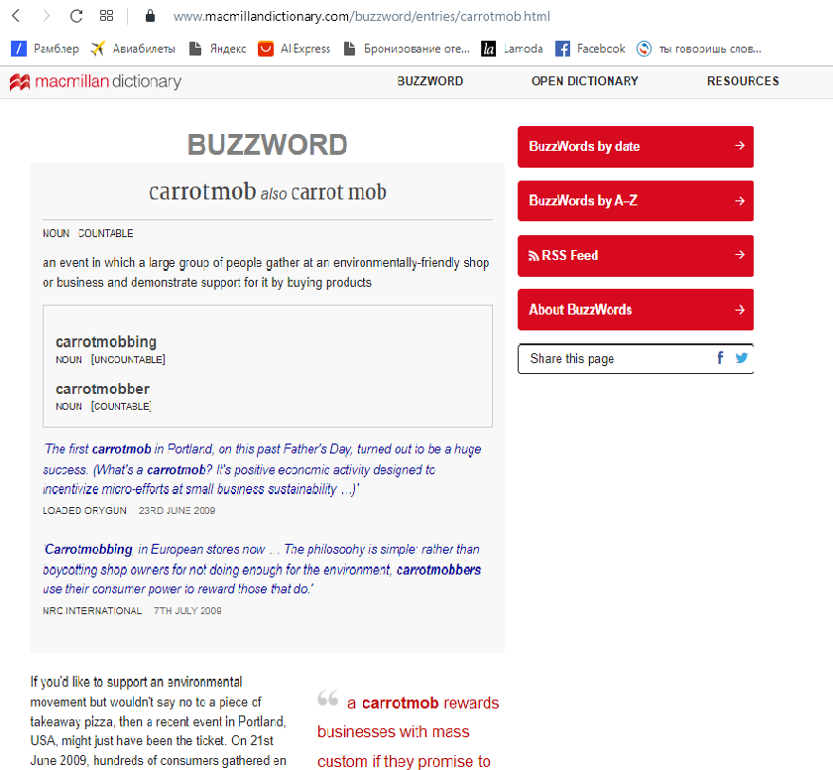
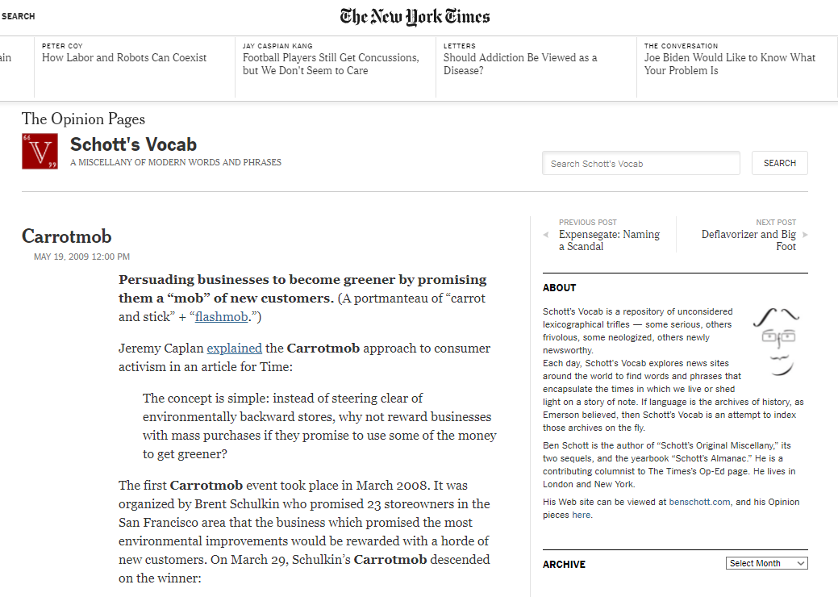
Explain the meaning of the following words and expressions:
earth hour, climate action, climate canary, rewilding.

Slide 11
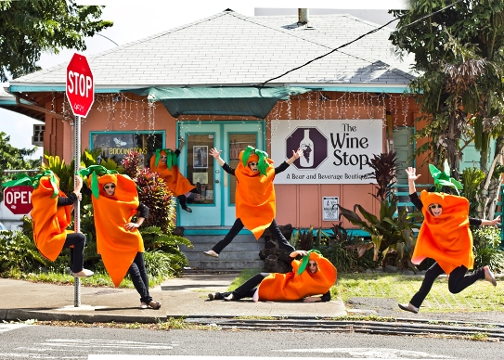
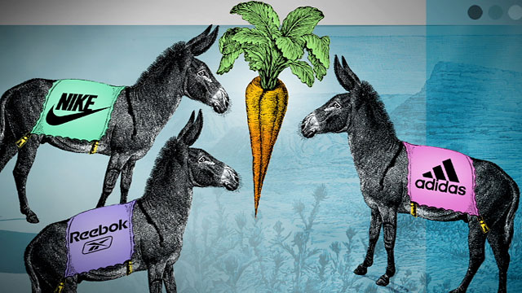
Consider the following diagramme. Comment on each of the concepts related to Corporate Social Responsibility. How are they interrelated?
Look at the pictures below. Do they fully reflect the idea of carrot mobbing? Explain your point of view.

Slide 12
ИСПОЛЬЗОВАНИЕ АУДИОВИЗУАЛЬНЫХ СРЕДСТВ
Pre-listening
You are going to watch a video produced by The School of Life, a global organisation dedicated to developing emotional intelligence. We've grown good at making many things in the modern world - but strangely the art of making attractive cities has been lost. The School of Life, in this video, provides some key principles for how to make attractive cities once again. Before you listen answer the following questions with a partner:
Do you think there are more attractive or ugly cities? Why?
Which cities are more appealing: the ancient ones or the modern ones? Prove your point.
Listening for gist and speaking
Now watch the first part of the video and check your predictions. Do you agree with the authors of the video?

Slide 13
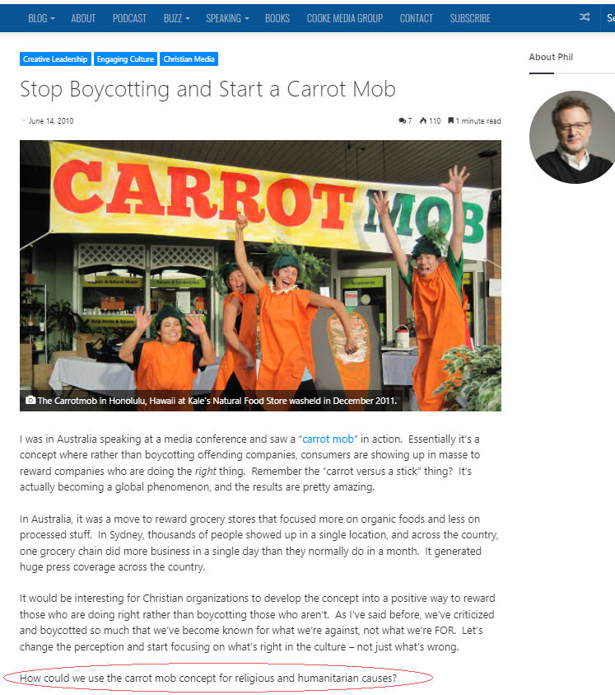
БЛОГ-ТЕХНОЛОГИЯ - публичность - мультимедийность - линейность - авторство и модерация - обучение письменной речи (эссе, статьи, рецензии) - сетевая дискуссия (личные блоги, блог преподавателя, блог группы) - устная речь (дискуссия)

Slide 14
СПАСИБО ЗА ВНИМАНИЕ!

