Slide 1
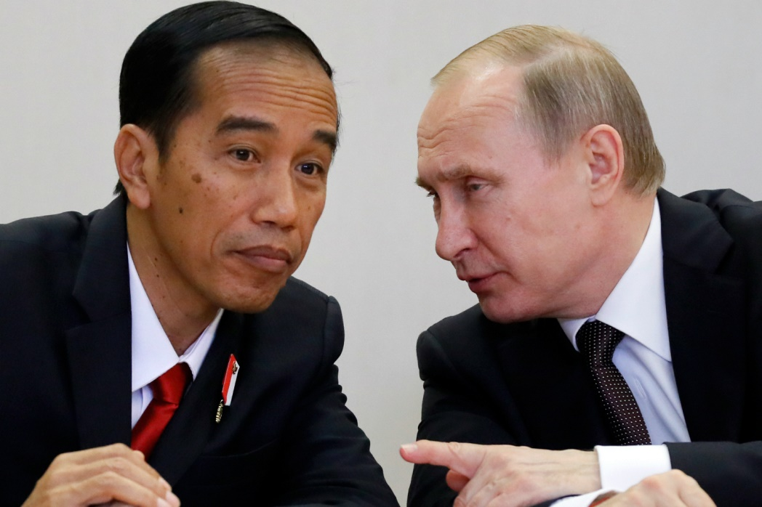
Indonesia-Russia economic co-operation during the President Joko Widodo administration, 2014-2021
Presentation prepared by:
Defi Anita Jahro

Slide 2
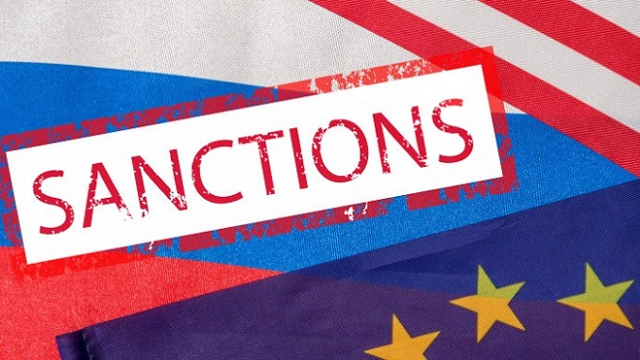
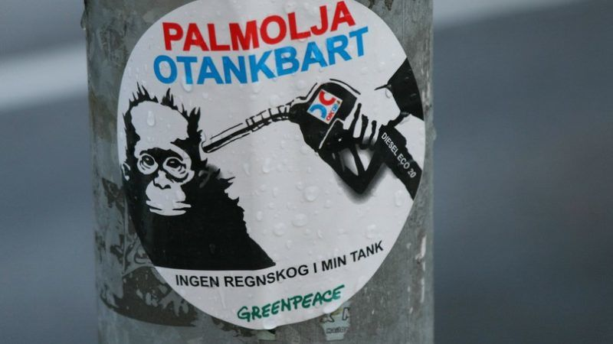

Slide 3
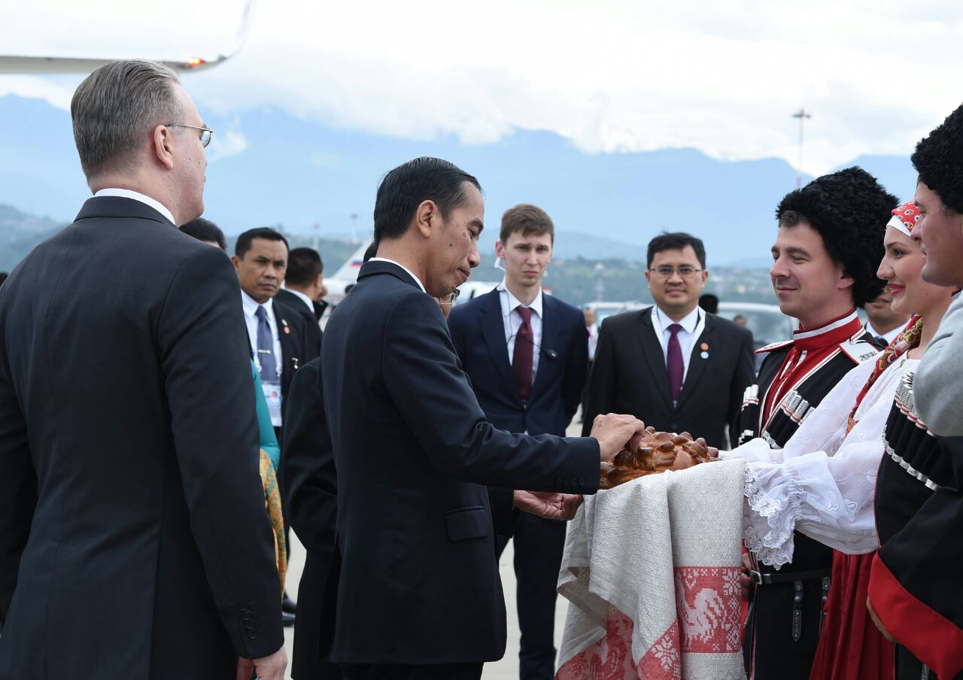
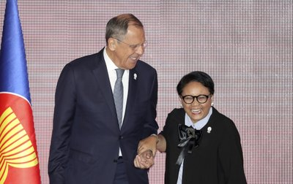
High profile state visit

Slide 4
Remove trade barrier
FTA Indonesia-EAEU

Slide 5
Indonesia-Russia Trade Balance
Average trade balance in the last 5 years of USD 2.3 billion
2020 trade balance between Indonesia and Russia recorded a surplus on the Indonesian side of USD 16 million
Russia's direct investment in 2020 was recorded at USD 4.6 million with 202 projects

