Slide 1
ADMISSION OF FOREIGNERS FOR STUDIES AT RGGU IN 2023
MA

Slide 2
Foreigners and Russian citizens have the same conditions in terms of time for the acceptance of documents, the timing of entrance examination and tuition fees.
The deadlines for submission of documents
FREE TUITION (ALL FORMS OF EDUCATION)
from 26 June 2023 to 26 July 2023
FEE-PAYING EDUCATION (ALL FORMS OF EDUCATION)
from 26 June 2023 to 11 August 2023

Slide 3
Foreigners and Russian citizens have the same conditions in terms of time for the acceptance of documents, the timing of entrance examination and tuition fees.
The deadlines for submission of documents
FEE-PAYING EDUCATION (EXTRAMURAL STUDIES)
from 1 September 2023 to 14 September 2023
FEE-PAYING EDUCATION (EXTRAMURAL STUDIES using distance learning technologies) from 26 June to 14 September 2023

Slide 4
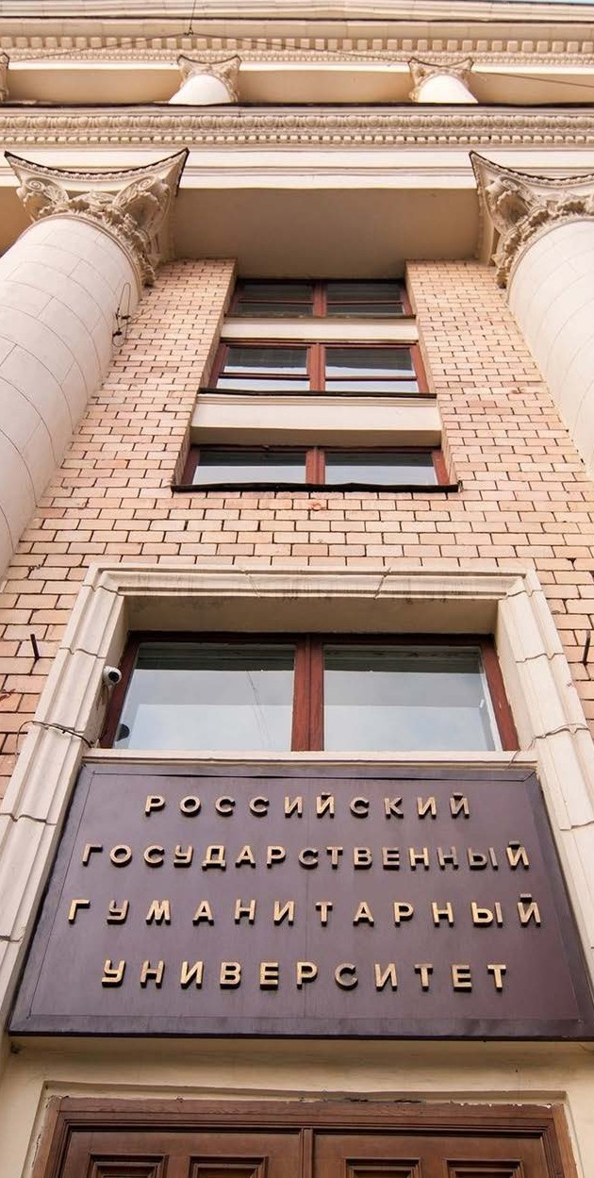
How to submit documents
Personally: Moscow, 15 Chayanova street, building 2;
Through public postal operators; Through the personal account of the applicant on the RGGU website https://www.rsuh.ru/abitur/

Slide 5
What documents are needed for admission
application for admission;
statement of consent to personal data processing;
passport: notarized copy of passport, notarized translation of passport (if there is no information in Russian in the document), visa page (if you have a visa)
a document of previous education with the supplement /transcript (if it is necessary with legalization/apostille) https://nic.gov.ru/ru/proc/lega):
notarized copy, notarized translation (if the document does not contain information in Russian),
documents confirming individual achievements (certificates, rewards, etc.);
3 photos 3cm*4cm (matte);
medical certificate on form 086/y or health certificate (with fluorography);
medical certificate of absence of HIV/AIDS;
medical insurance policy valid on the territory of the Russian Federation.

Slide 6
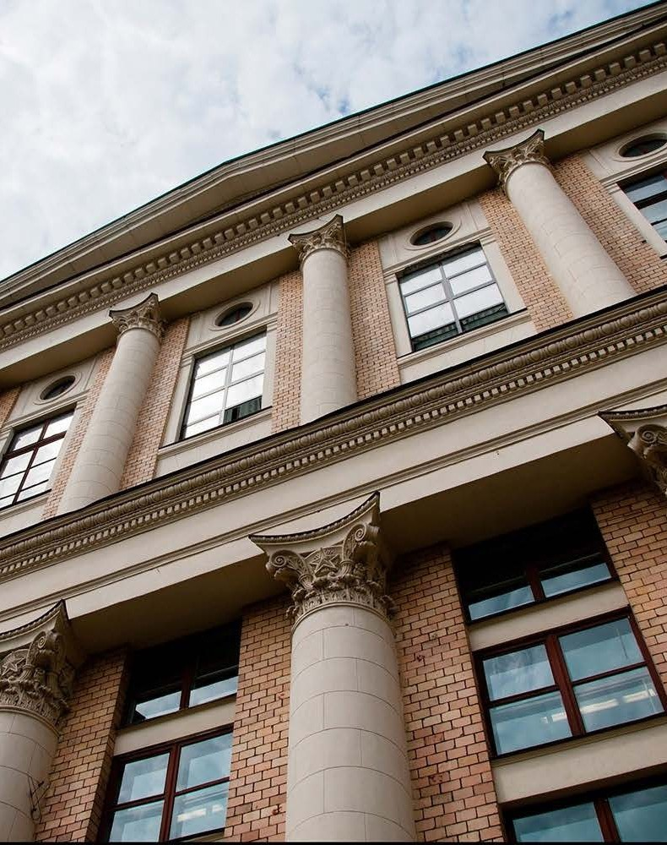
It is important
Additionally, you have to provide documents (birth certificate, passport) proving that your parents, grandparents are citizens of the Russian Federation or you were born in the Russian Federation or in the USSR for admission to the program «Compatriots living abroad».
Citizens who have a foreign document of education, should check in advance the need to pass the procedure of recognition of the document of education on the website of the company «Glavexpertcentre» (nostrification)(https://nic.gov.ru/ru/docs/foreign/confirmation).

Slide 7
Not only citizens of the Russian Federation, but also foreigners, stateless persons have the right to study at state-funded places of Russian universities. Representatives of the following states are:
citizens of the Republic of Belarus, the Republic of Kazakhstan, the Kyrgyz Republic, the Republic of Tajikistan living in their countries;
Who can apply for free tuition
citizens of the Republic of Azerbaijan, the Republic of Armenia, the Republic of Belarus, the Republic of Kazakhstan, the Kyrgyz Republic, the Republic of Moldova, the Republic of Tajikistan, the Republic of Uzbekistan, Ukraine, Turkmenistan, Georgia, permanently living in the territory of the Russian Federation (having a residence permit);
compatriots living abroad.

Slide 8
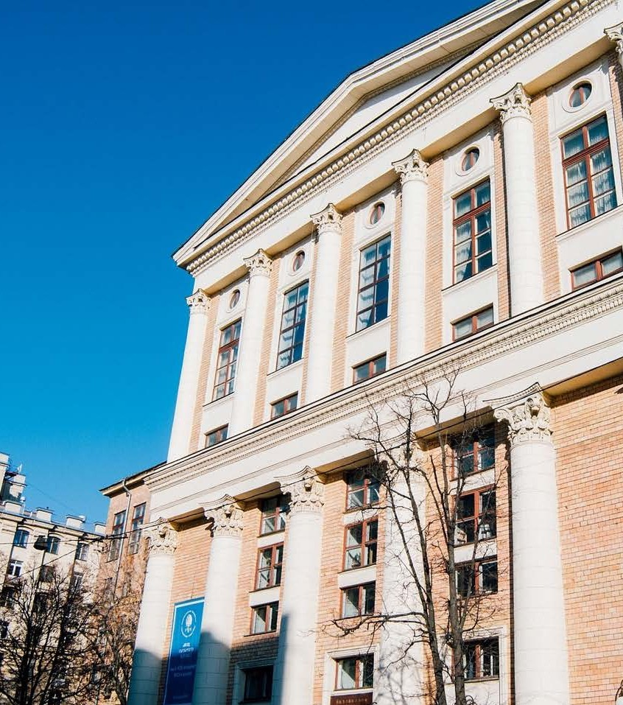
Studying at RGGU within the quota for education of foreigners and stateless persons in the Russian Federation
Foreigners have the opportunity to study free of charge within the quota established by the Government of the Russian Federation for the education of foreigners and stateless persons in the Russian Federation.
All information on the website: https://future-in-russia.com/

Slide 9
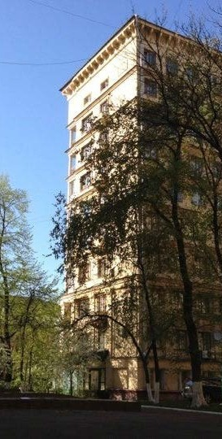
Contract training for the provision of fee-paying educational services
All foreigners and stateless persons have the opportunity to study at the RGGU on a paid basis with a positive result of the entrance examination.
The cost of studying for foreigners is equal to the cost of studying Russian citizens at RGGU.

Slide 10
Entrance exams to RGGU
One entrance examination is given in the chosen direction of the master's degree programme, taking into account the profile of the master's programme: an oral exam or written testing in Russian.
The entrance examination in the field of Philology (Theory and practice of translation) is conducted in writing: a written translation and a grammar test in two foreign languages).

Slide 11
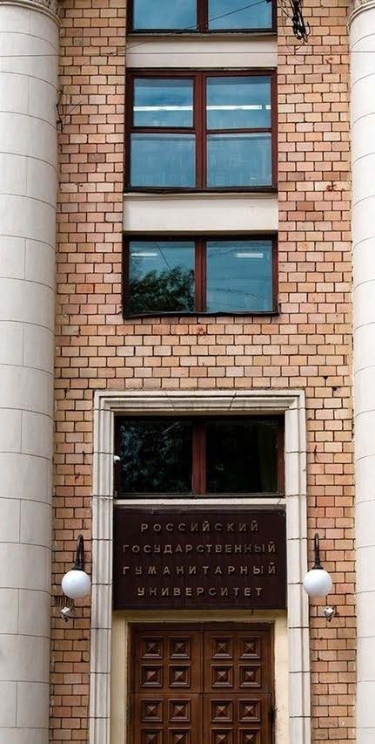
Entrance exams to RGGU
FREE TUITION (ALL FORMS OF EDUCATION)
from 31 July 2023 to 2 August 2023
FEE-РAYING EDUCATION (ALL FORMS OF EDUCATION)
from 31 July to 2 August; 16, 17 August 2023
The minimum passing score is 30.

Slide 12
Health insurance
Visa support
Foreign students who come to study at RGGU are required to make a medical insurance policy valid on the territory of the Russian Federation.
The necessary information on insurance issues can be obtained here:
Email: inter@rggu.ru
Phone : + 7 (495) 250-65-14
RGGU provides visa support to its students.
You have to provide an order for enrollment or a study contract and a paid receipt to issue a visa invitation.
Contacts of the Visa Department:
Email : welcome@rggu.ru
Phone: + 7 (495) 250-63-54

Slide 13
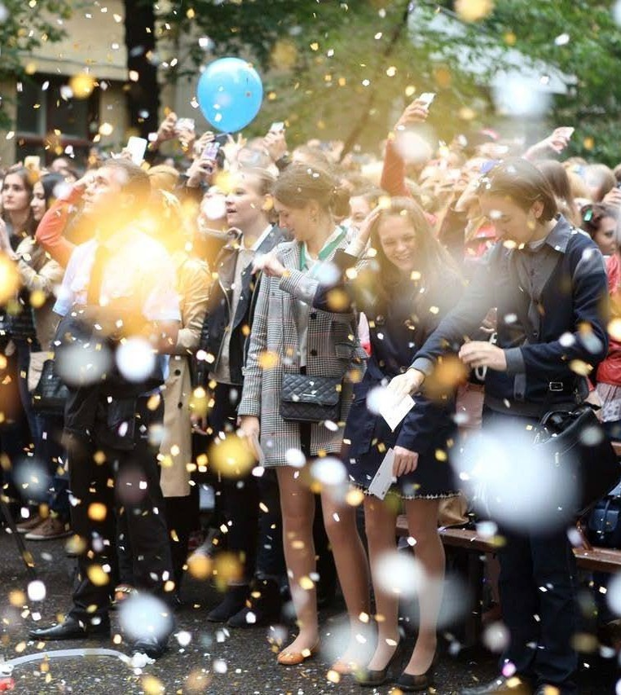
Dormitory: Website of the RGGU dormitory : https://www.rsuh.ru/hostel/
Extracurricular activities:
There is an active extracurricular activity at the RGGU.
More detailed: https://www.rsuh.ru/student/our-activities/

Slide 14
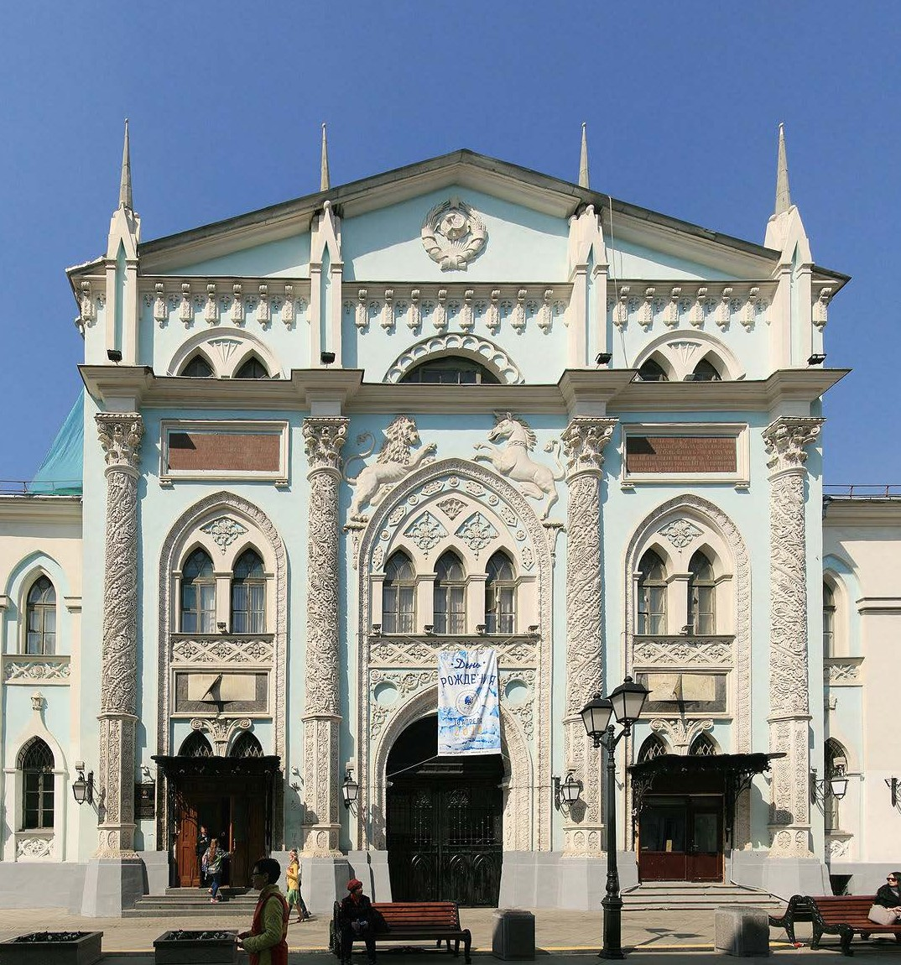
Contacts
Admissions Committee for foreigners:
+7 (495) 250-65-14, 250-61-80
inter@rggu.ru https://www.rsuh.ru/applicant/admissions-2021/
International Department: inter@rggu.ru https://www.rsuh.ru/international/international- relations-office/
Distance Education Centre:
+7 (495) 250-61-10, +7 (495) 250-61-11
priem.do@rggu.ru https://www.rsuh.ru/dot/coming.php
Department of Fee-Paying Education Services:
+7 (495) 250-66-25
upou2@rggu.ru https://www.rsuh.ru/applicant/section_139/

Slide 15
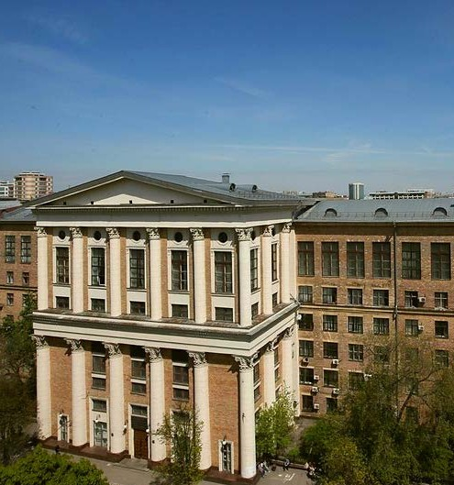
Contacts
Preparatory courses for the United State Exam, State Final Assessment, entrance exams of RGGU:
+7 (495) 250-71-48
kursy@rggu.ru , licey@rggu.ru http://cdo.rggu.ru/section.html?id=12533
Inclusive education at RGGU:
https://www.rsuh.ru/education/inclusive/
Student Affairs Department: https://www.rsuh.ru/student/about-department/
Dormitory:
https://www.rsuh.ru/hostel/

Slide 16
Useful links
Ministry of Science and Higher Education of the Russian Federation : https://www.minobrnauki.gov.ru/
Main State Centre for Education Evaluation (Glavexpertcentre): https://nic.gov.ru/
Information portal «Future in Russia»:
https://future-in-russia.com/
The Federal Agency for the Commonwealth of Independent States Affairs, Compatriots Living Abroad, and International Humanitarian Cooperation (Rossotrudnichestvo) http://rs.gov.ru/%20/about

Slide 17
Admissions Committee for international students
International Department
Phone: +7 (495) 250-65-14, +7 (495) 250-61-80
Email: inter@rggu.ru

